Slide 1
Chapter
5
4
Arrangements of e-'s in atoms
Light is dual in nature

Slide 7
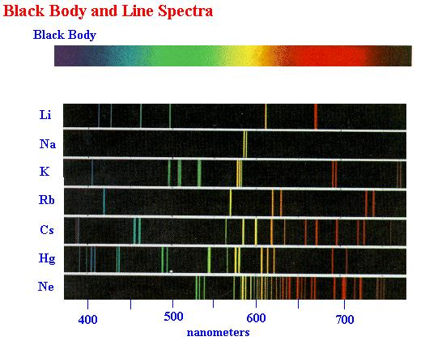

Slide 8
